Slide 1
CM3070 Pitch
Physics-based game

Slide 2
Boardgames

Slide 3
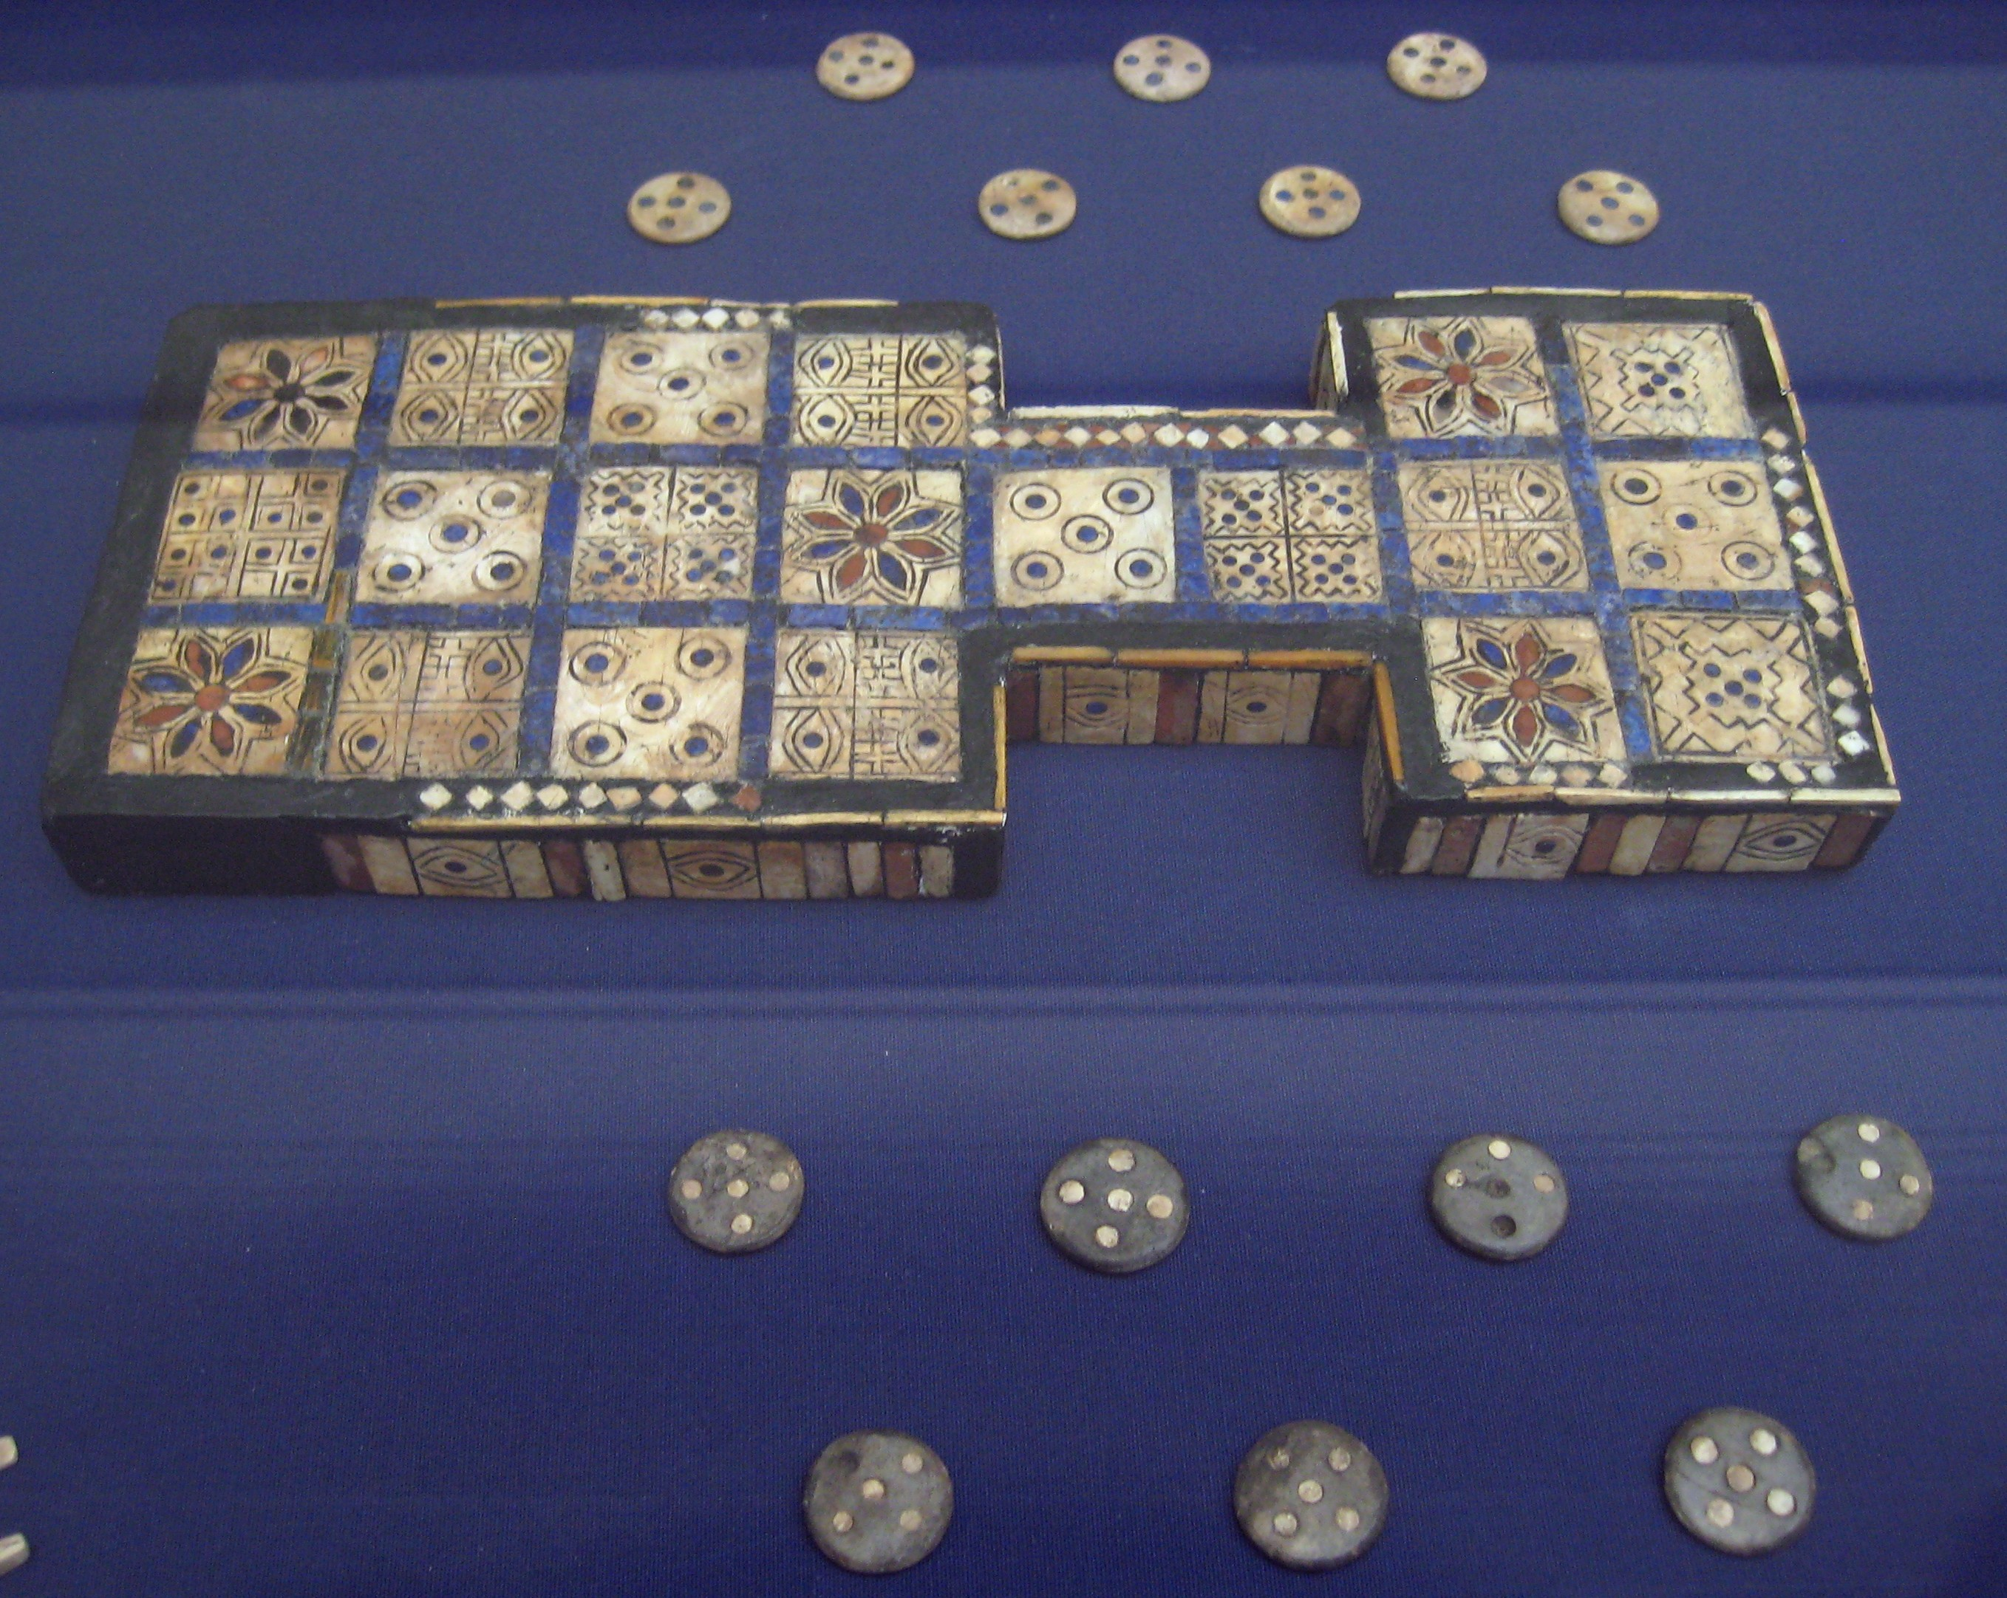
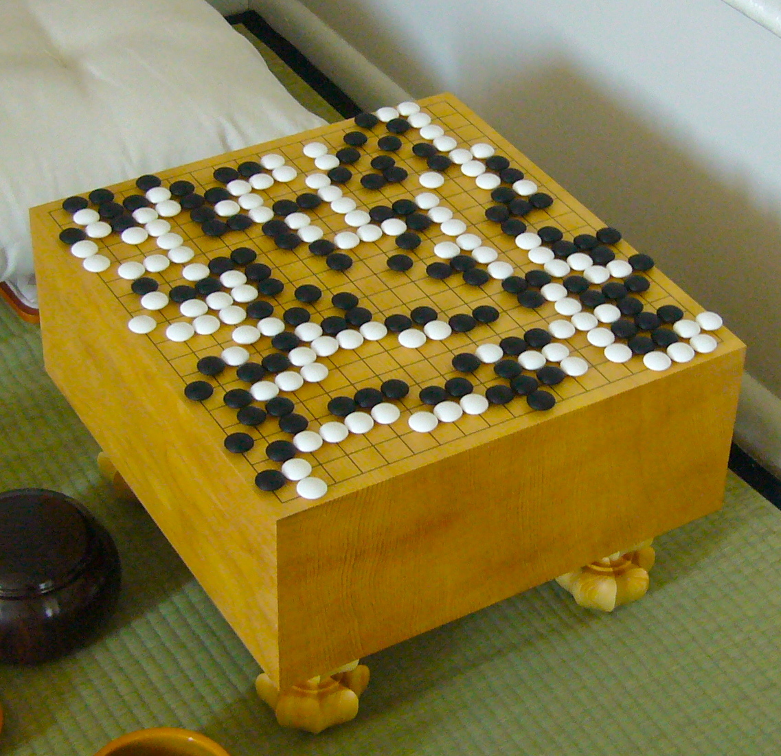
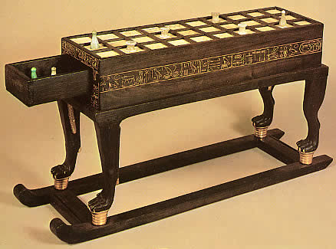
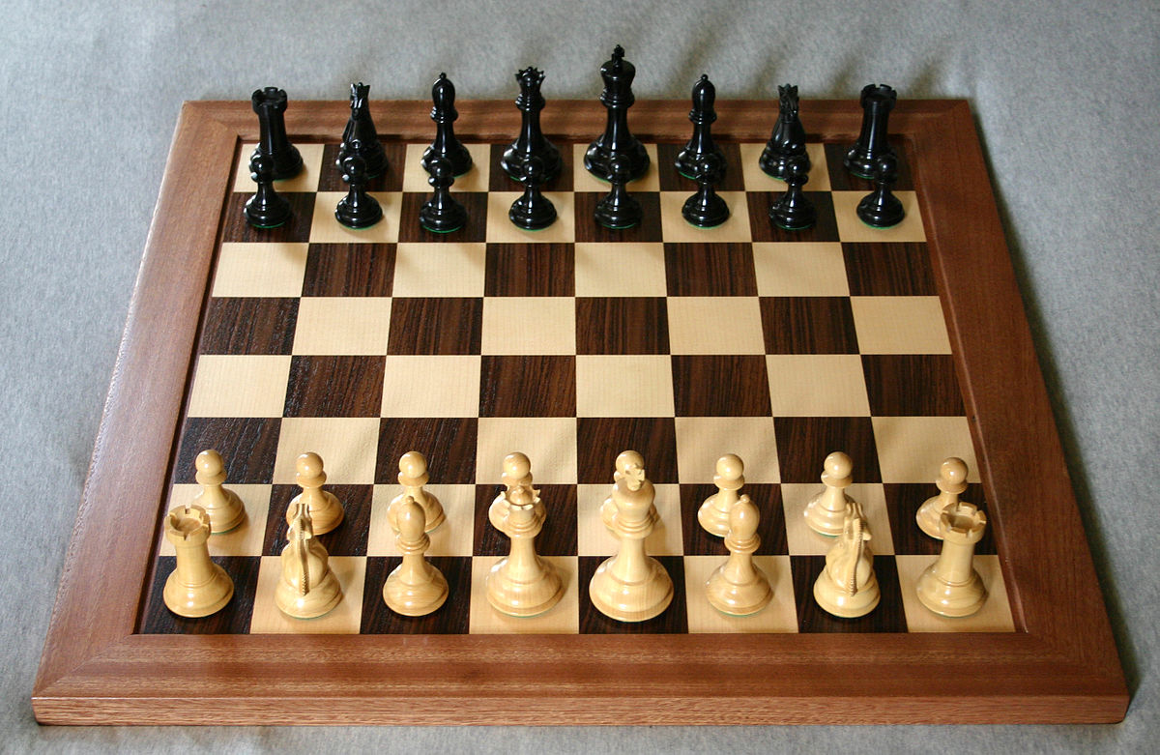
Boardgames
Royal Game of Ur: c.2600 BCE, Mesopotamia
Go: c.4000 BCE, China
Senet: c.2600 BCE, Egypt
Chess: c.1475 CE, Europe

Slide 4
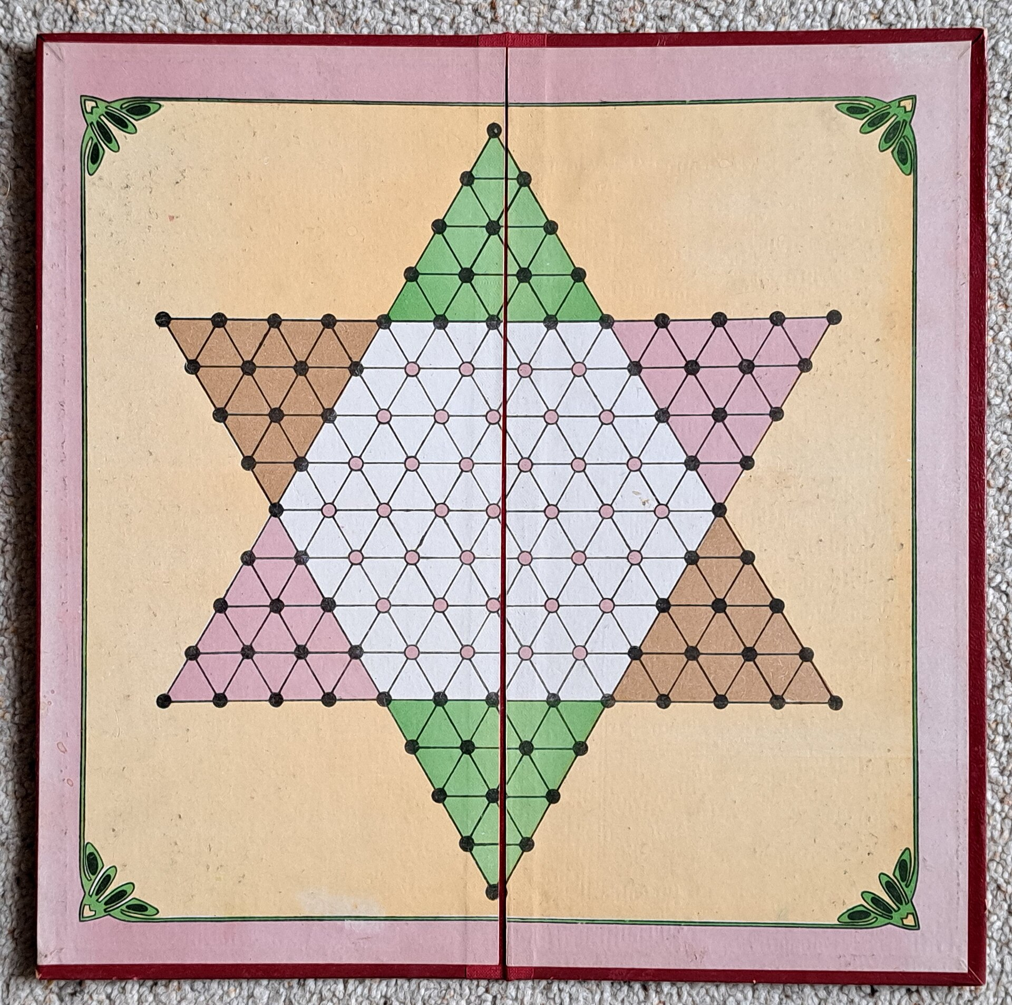
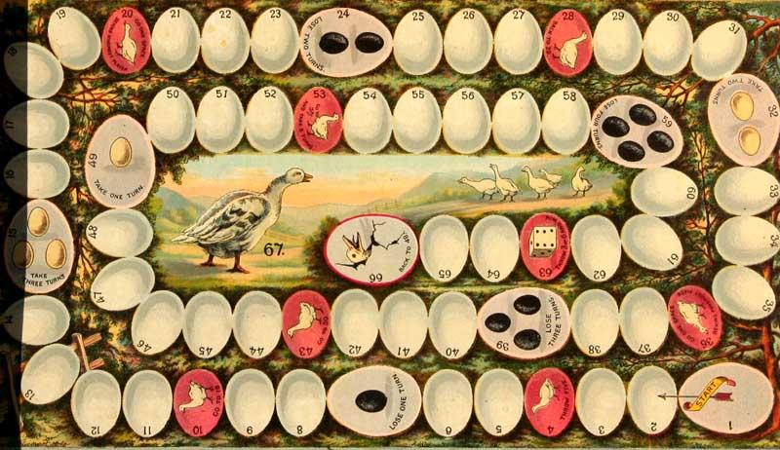
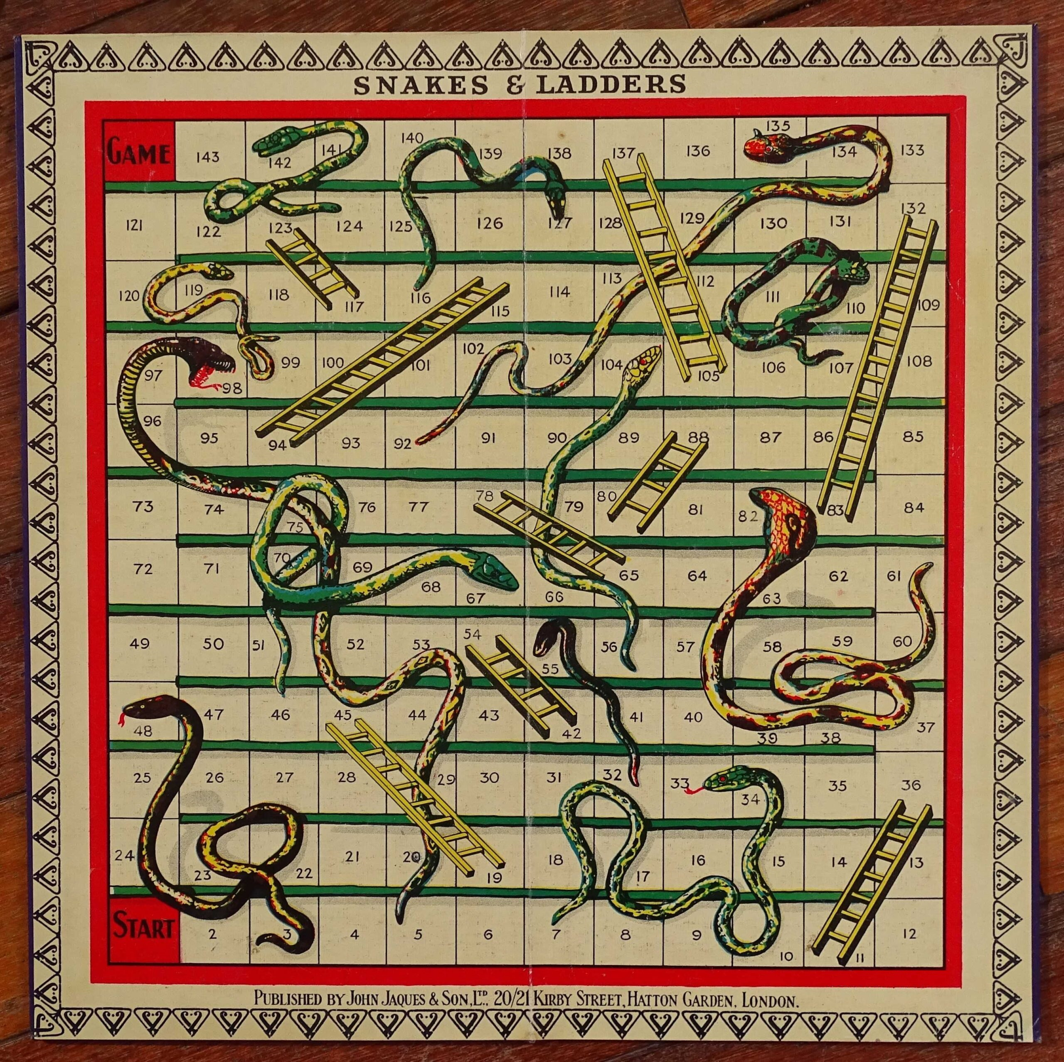
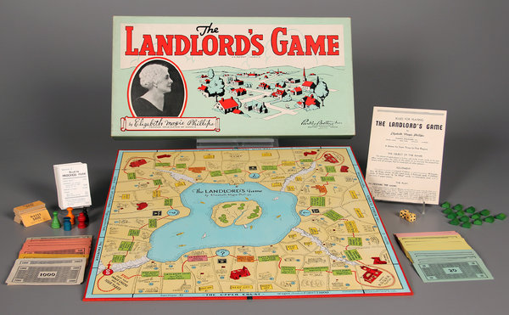
Boardgames
The Game of the Goose, c.1880
Halma (Chinese Checkers), 1883
Snakes & Ladders, 1890
The Landlord’s Game, 1904

Slide 5
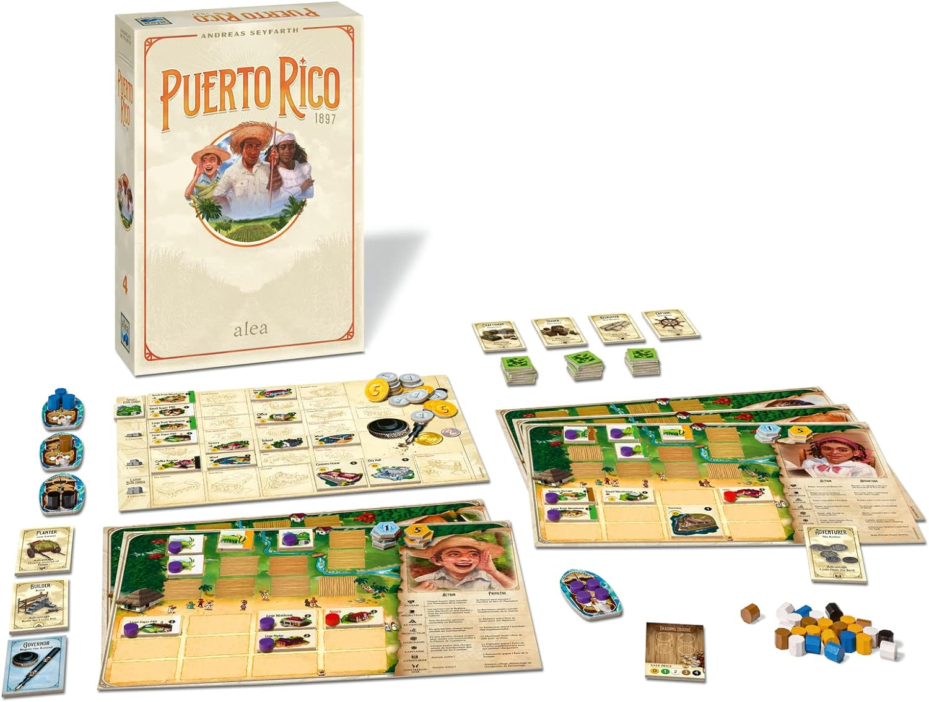
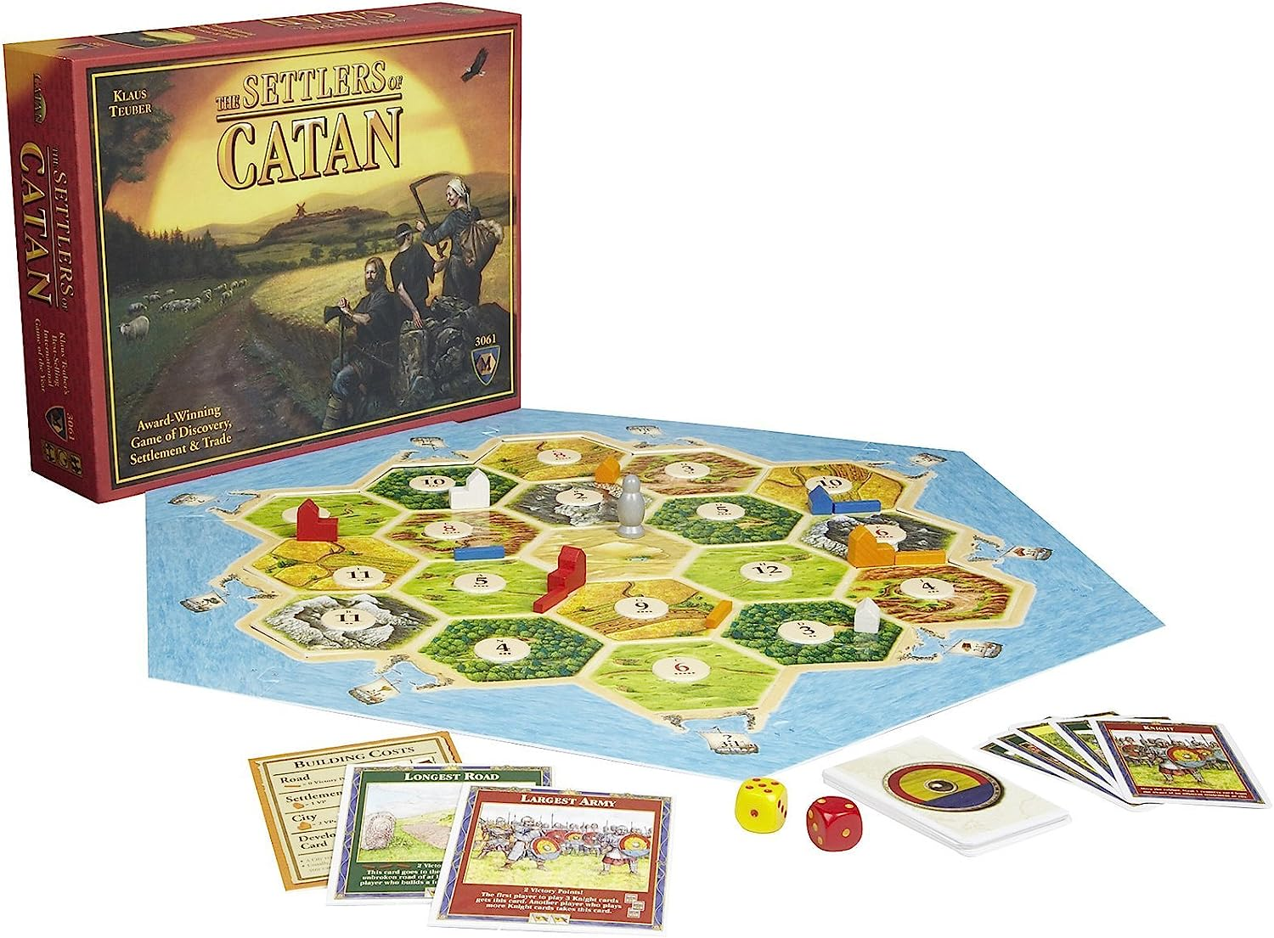
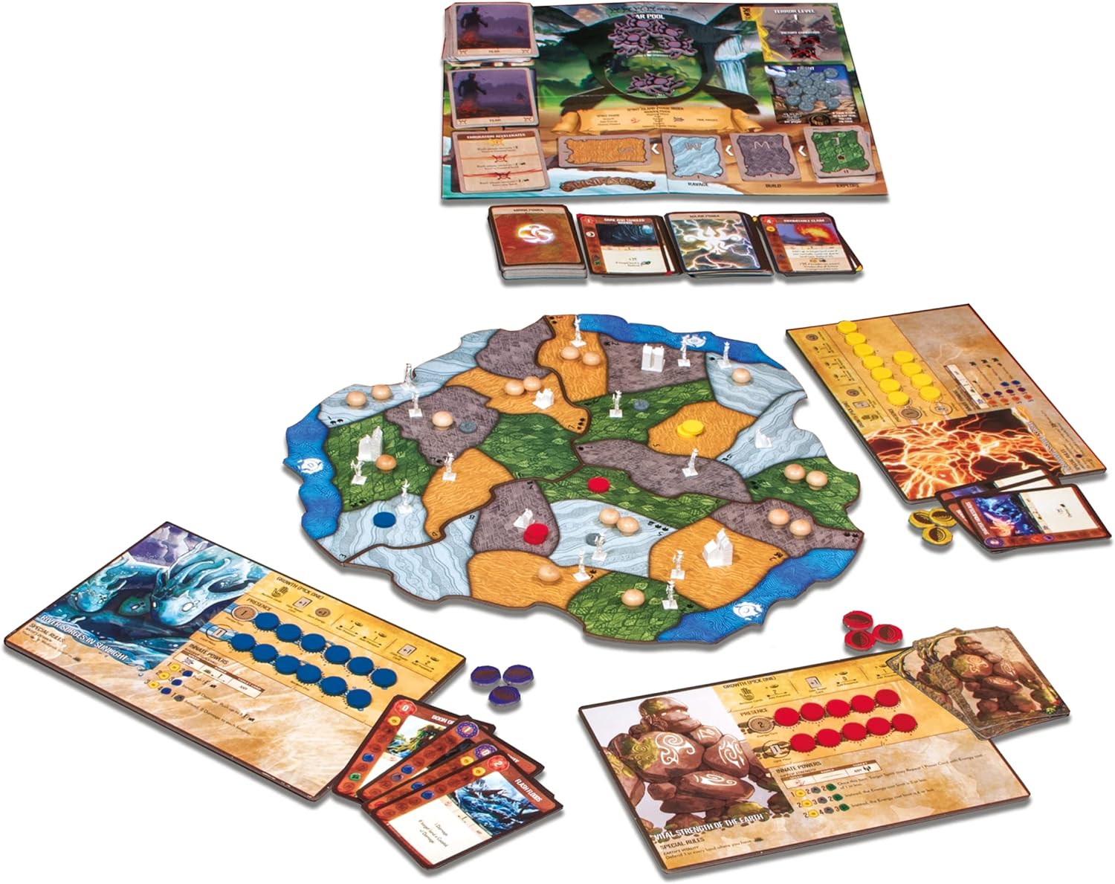
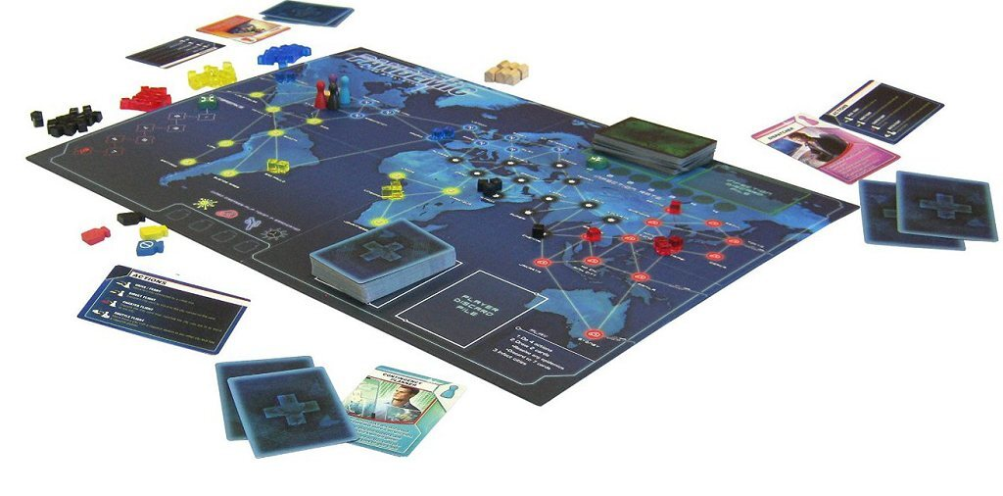
Boardgames
Puerto Rico, 2002
The Settlers of Catan, 1995
Spirit Island, 2017
Pandemic, 2008

Slide 6
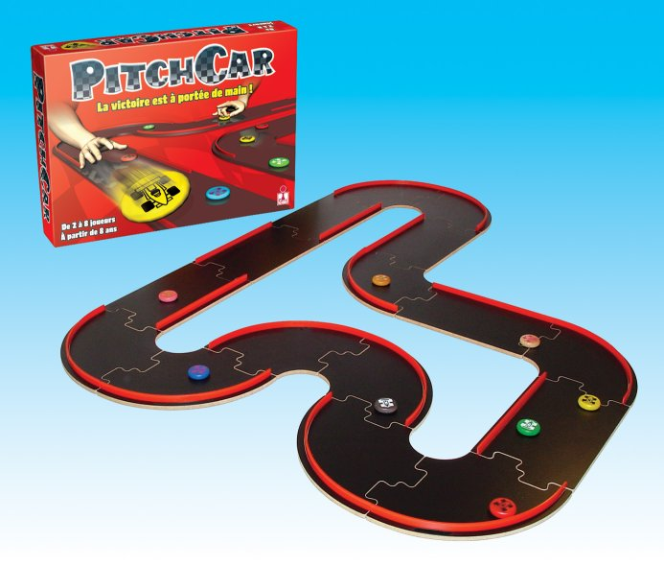
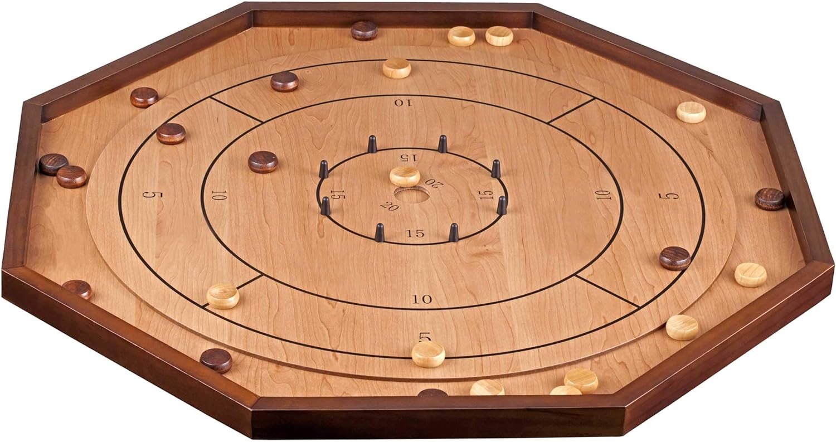
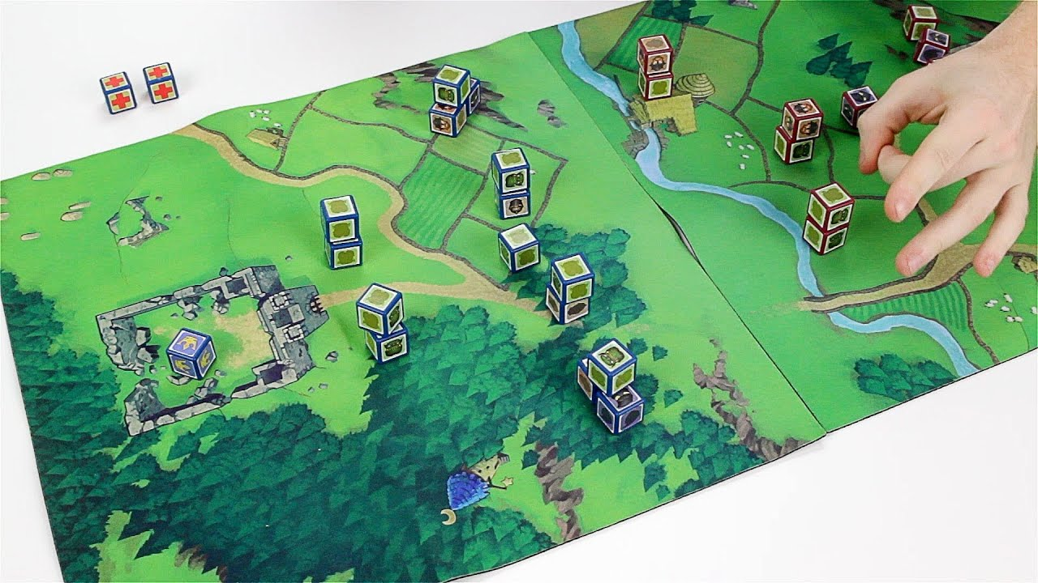
Dexterity games
Crokinole, 1876
PitchCar, 1995
Cube Quest, 2013

Slide 7
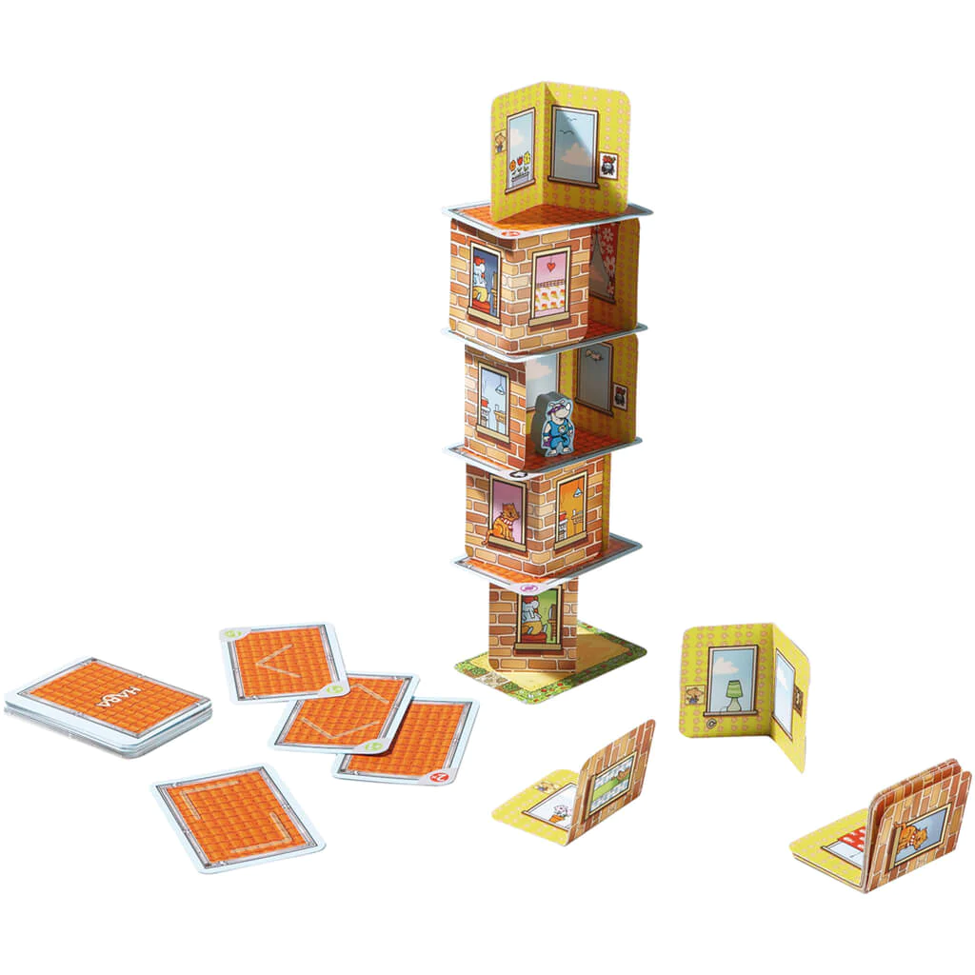
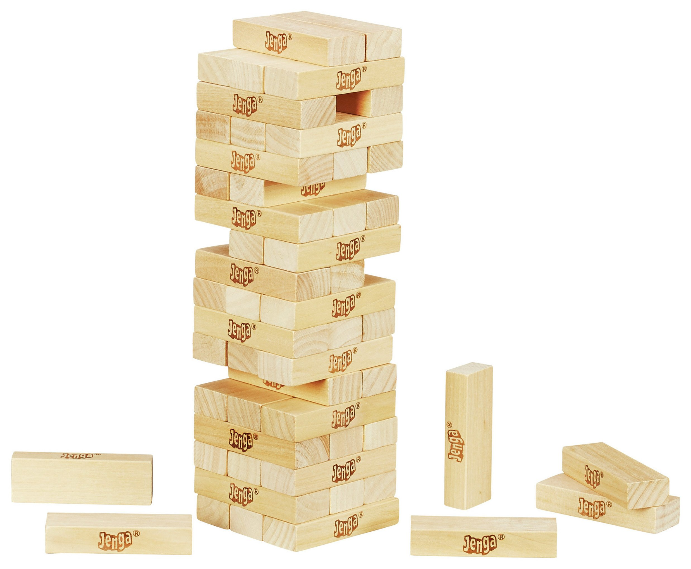
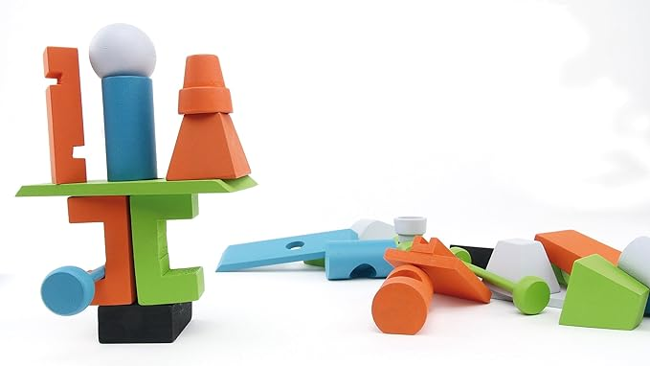
Dexterity games
Rhino Hero, 2011
Jenga, 1983
Junk Art, 2016

Slide 8
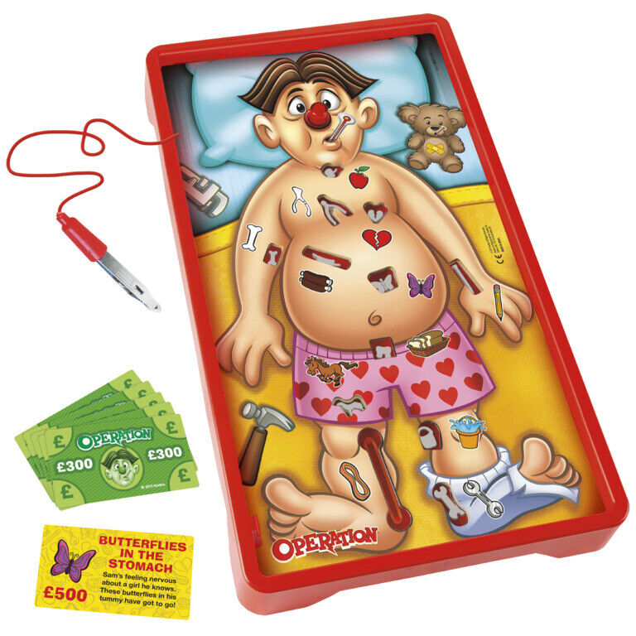
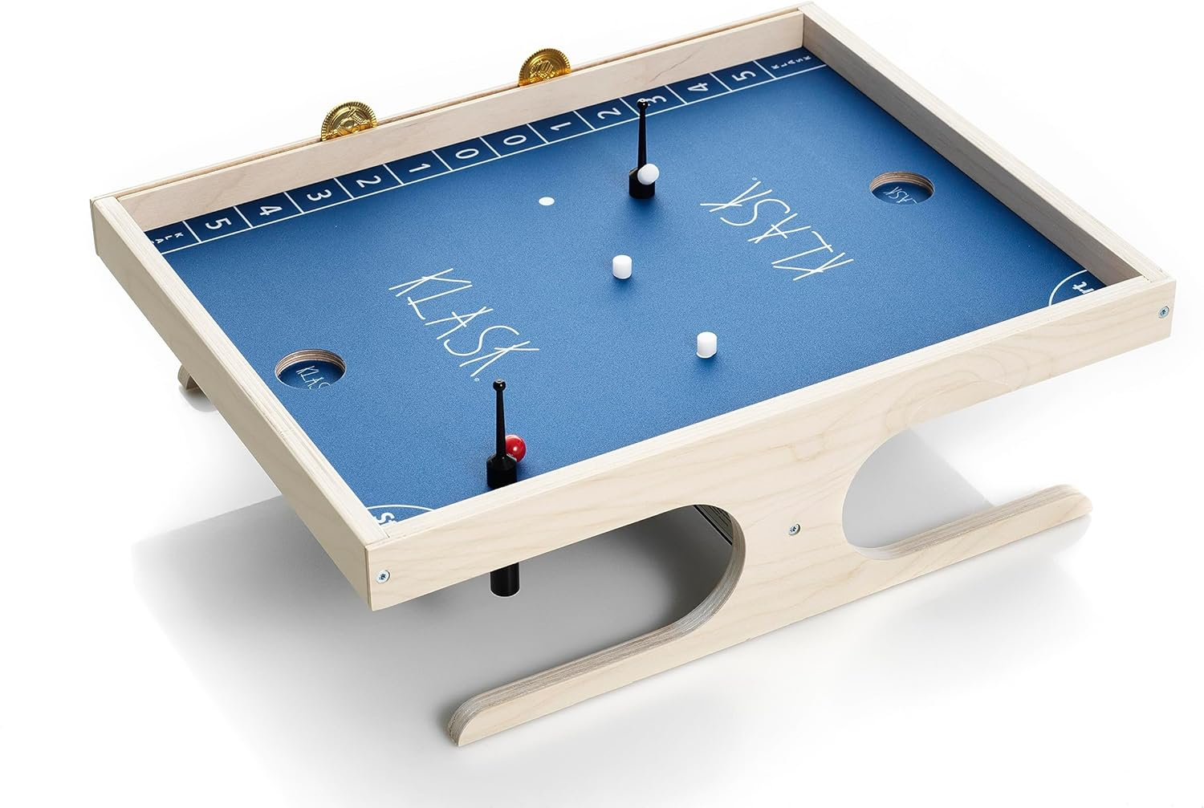
Dexterity games
Operation, 1965
Klask, 2014

Slide 9
Digital boardgames

Slide 10

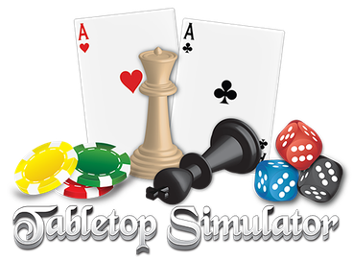
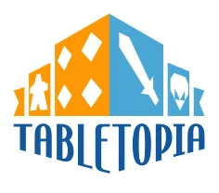
Digital boardgames

Slide 11
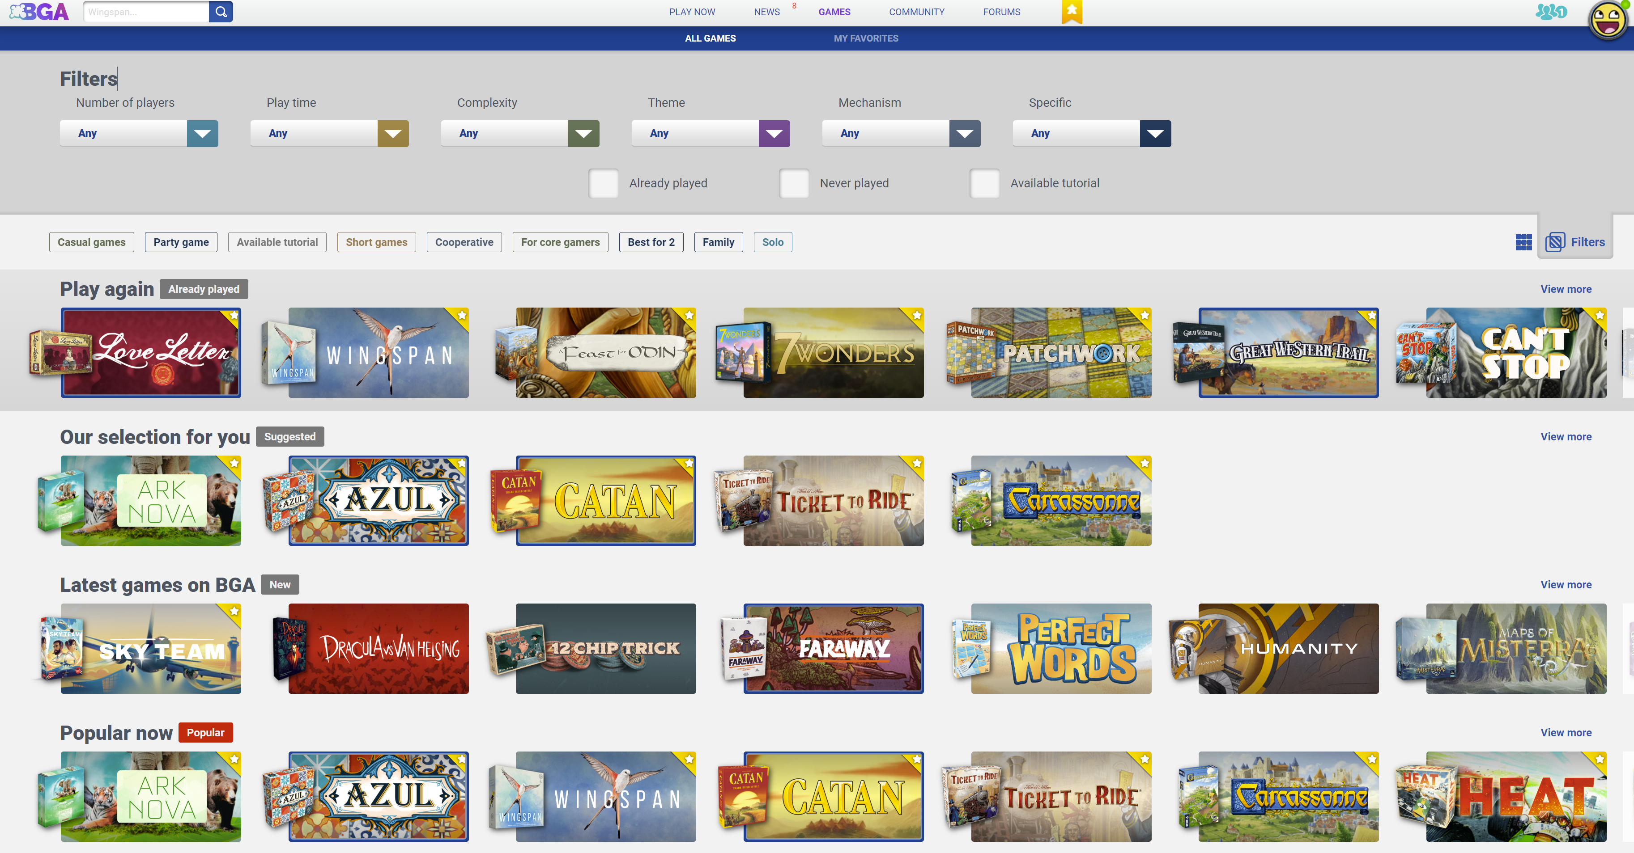
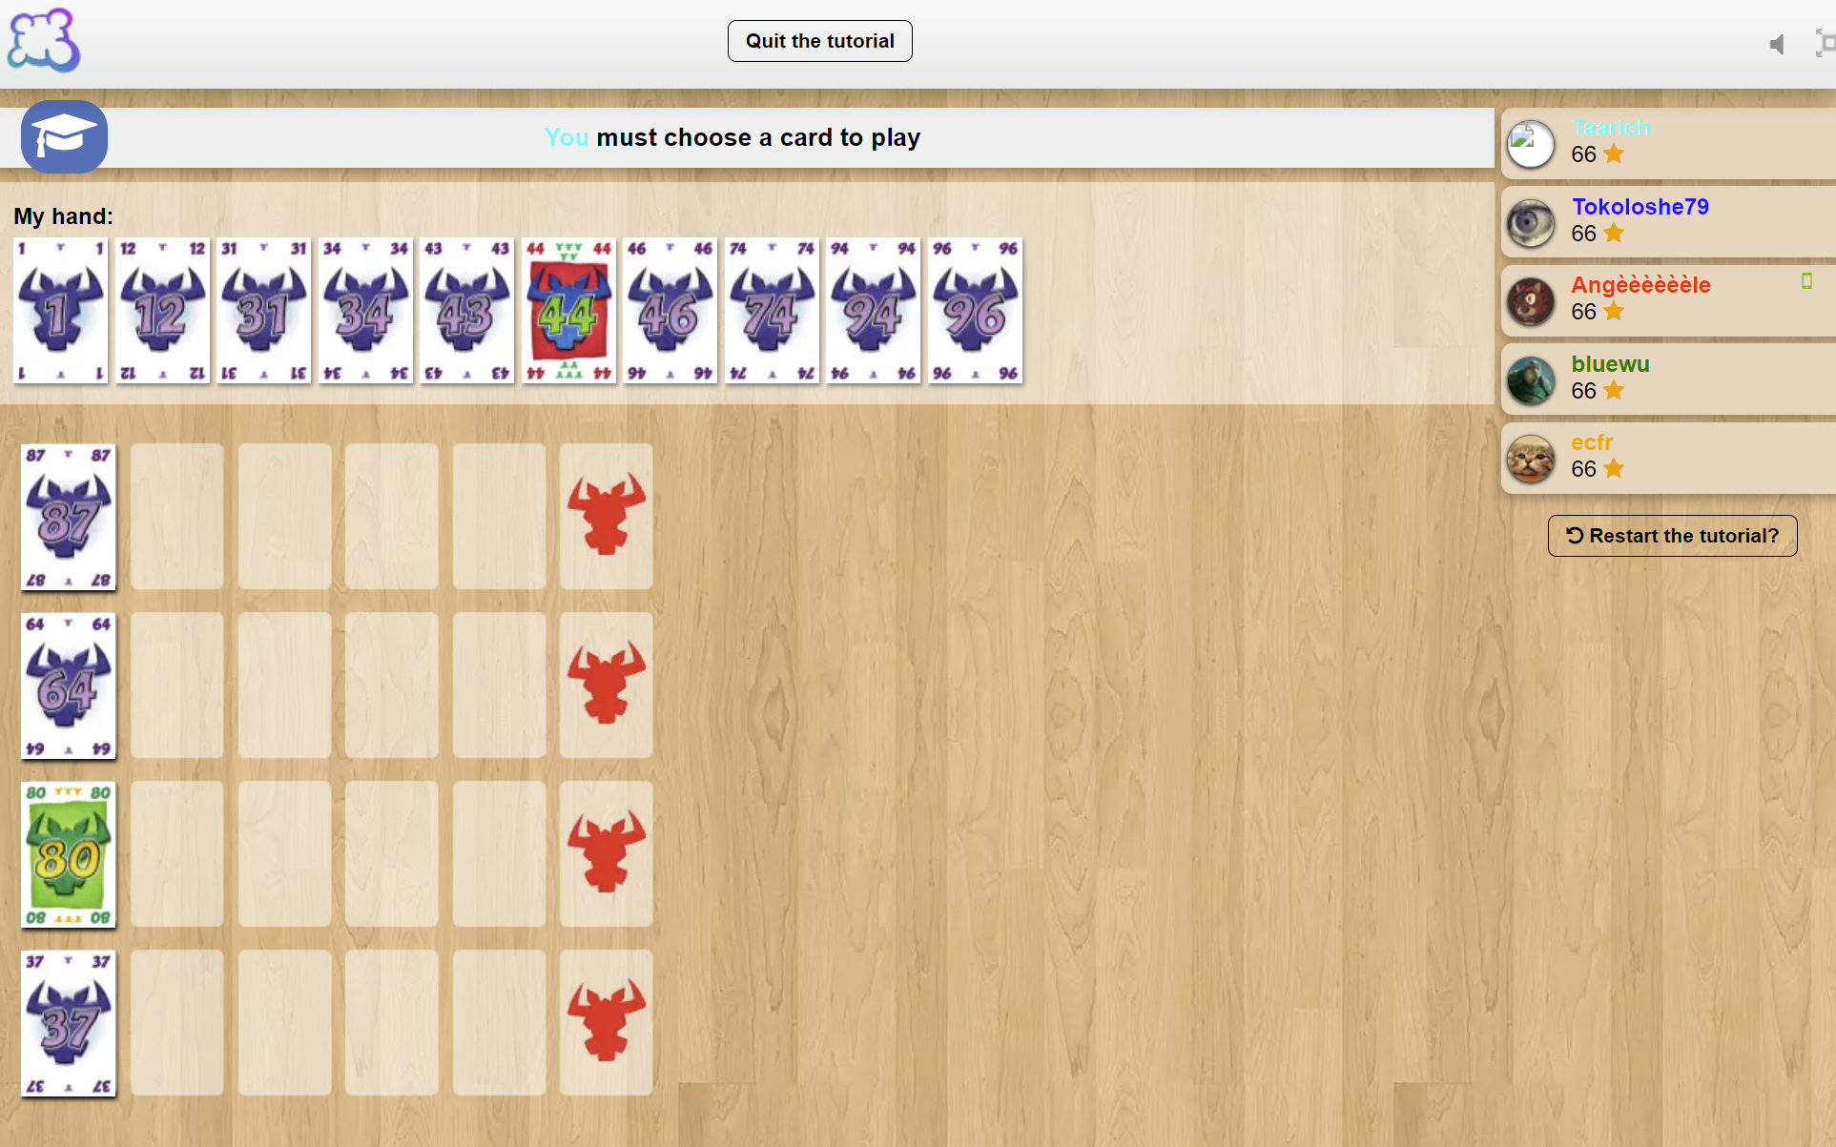
Digital boardgames

Slide 12
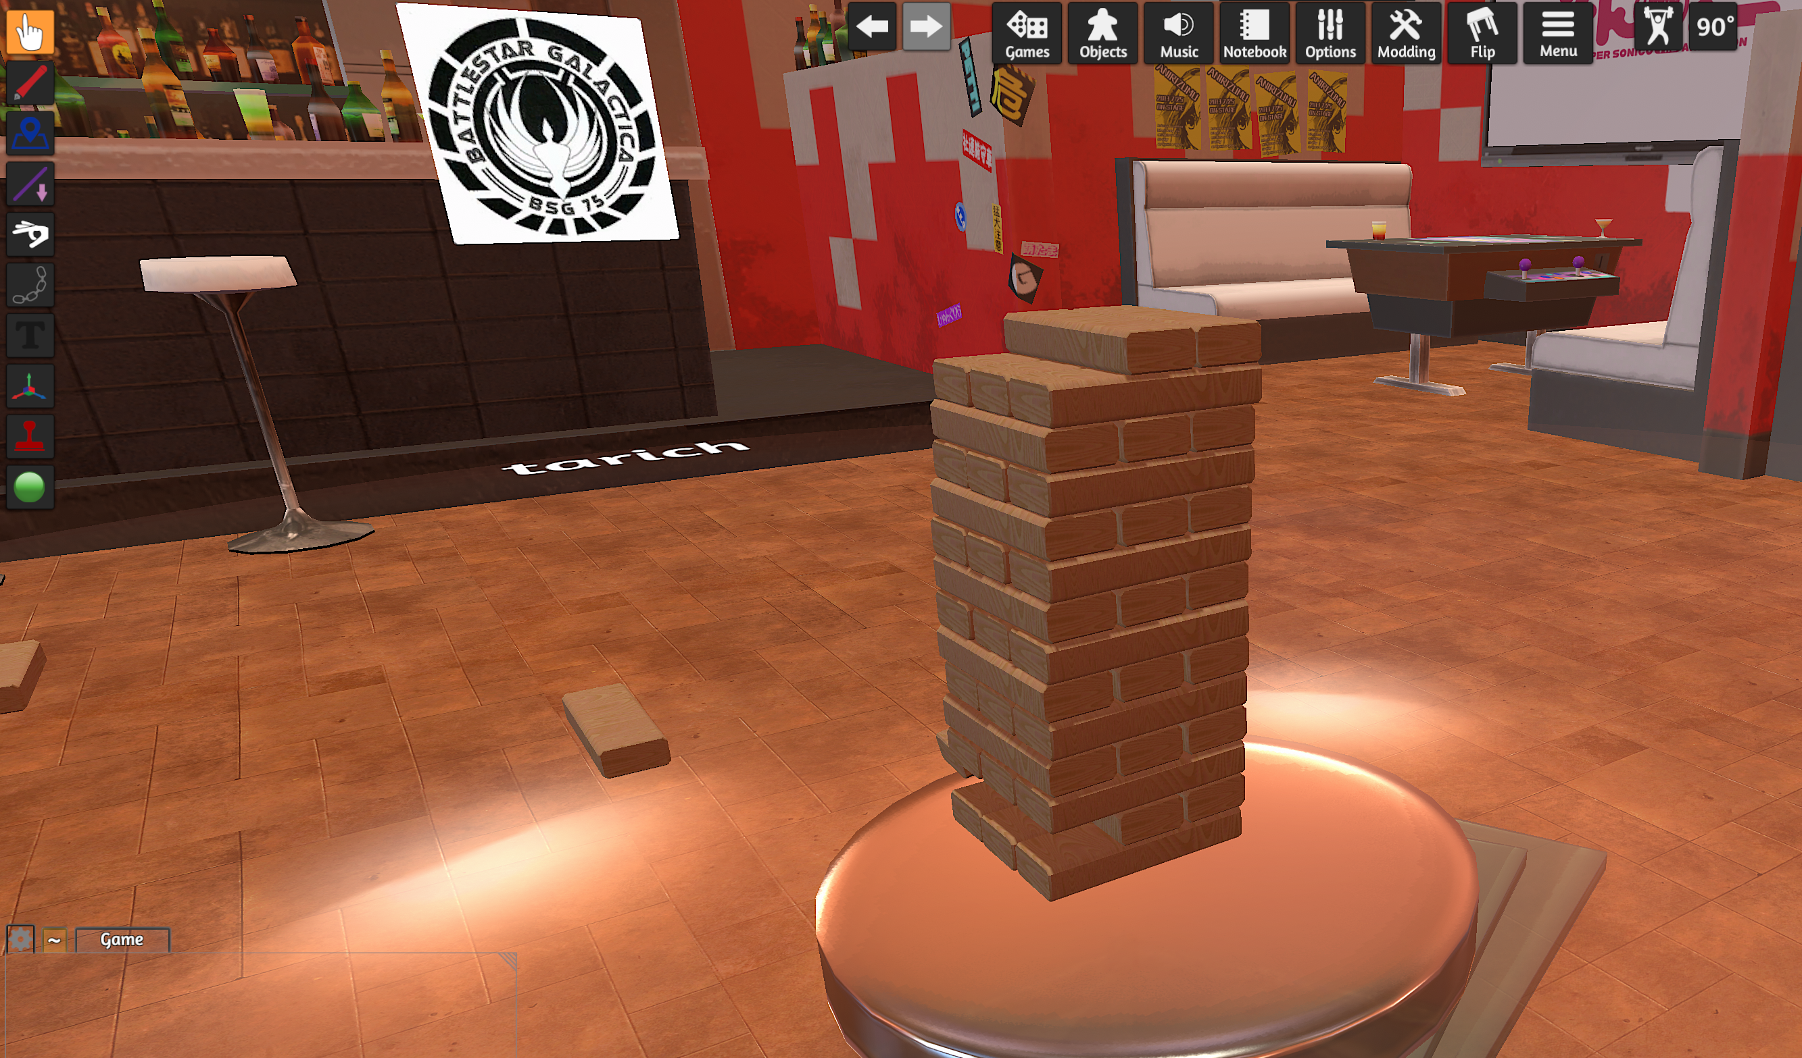
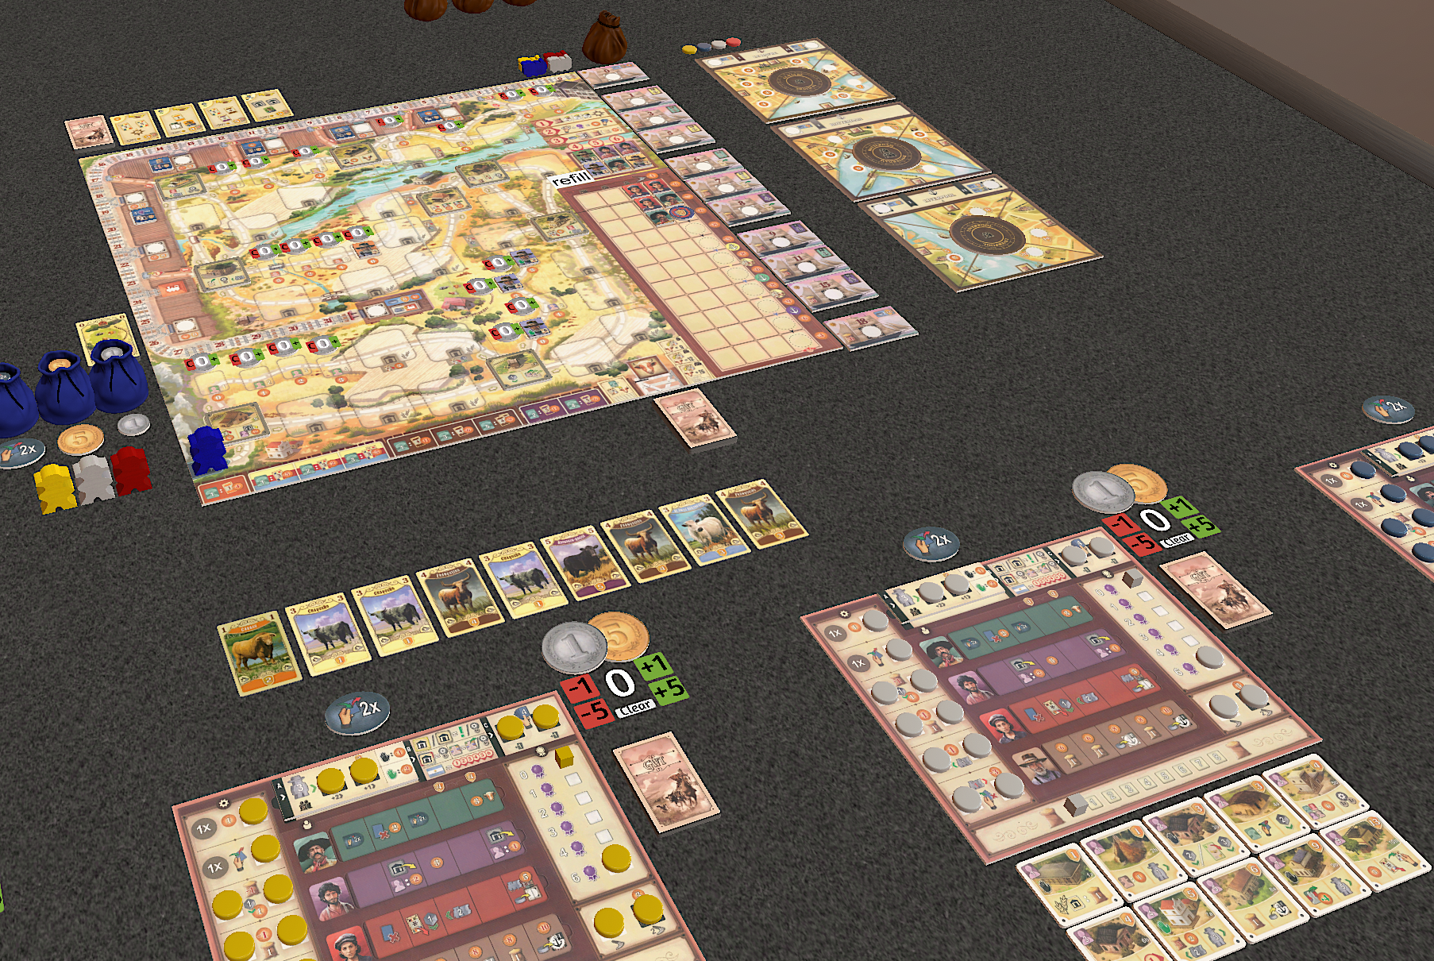
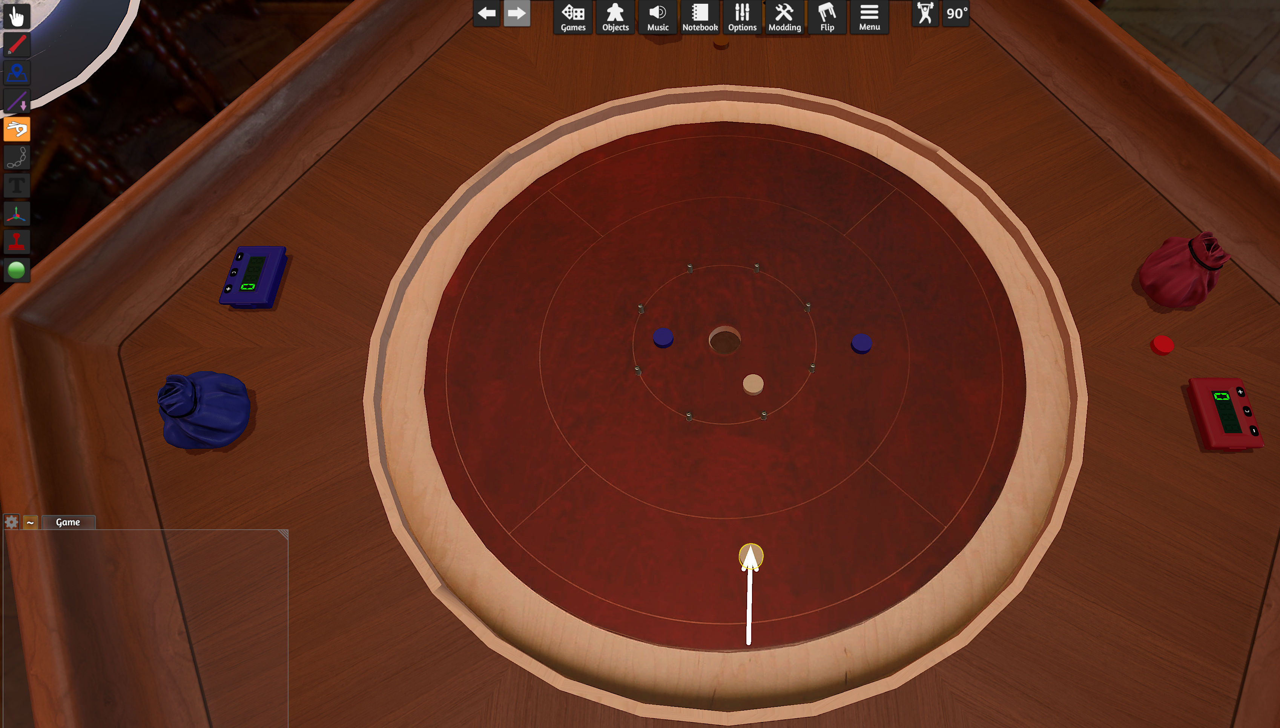
Digital boardgames

Slide 13
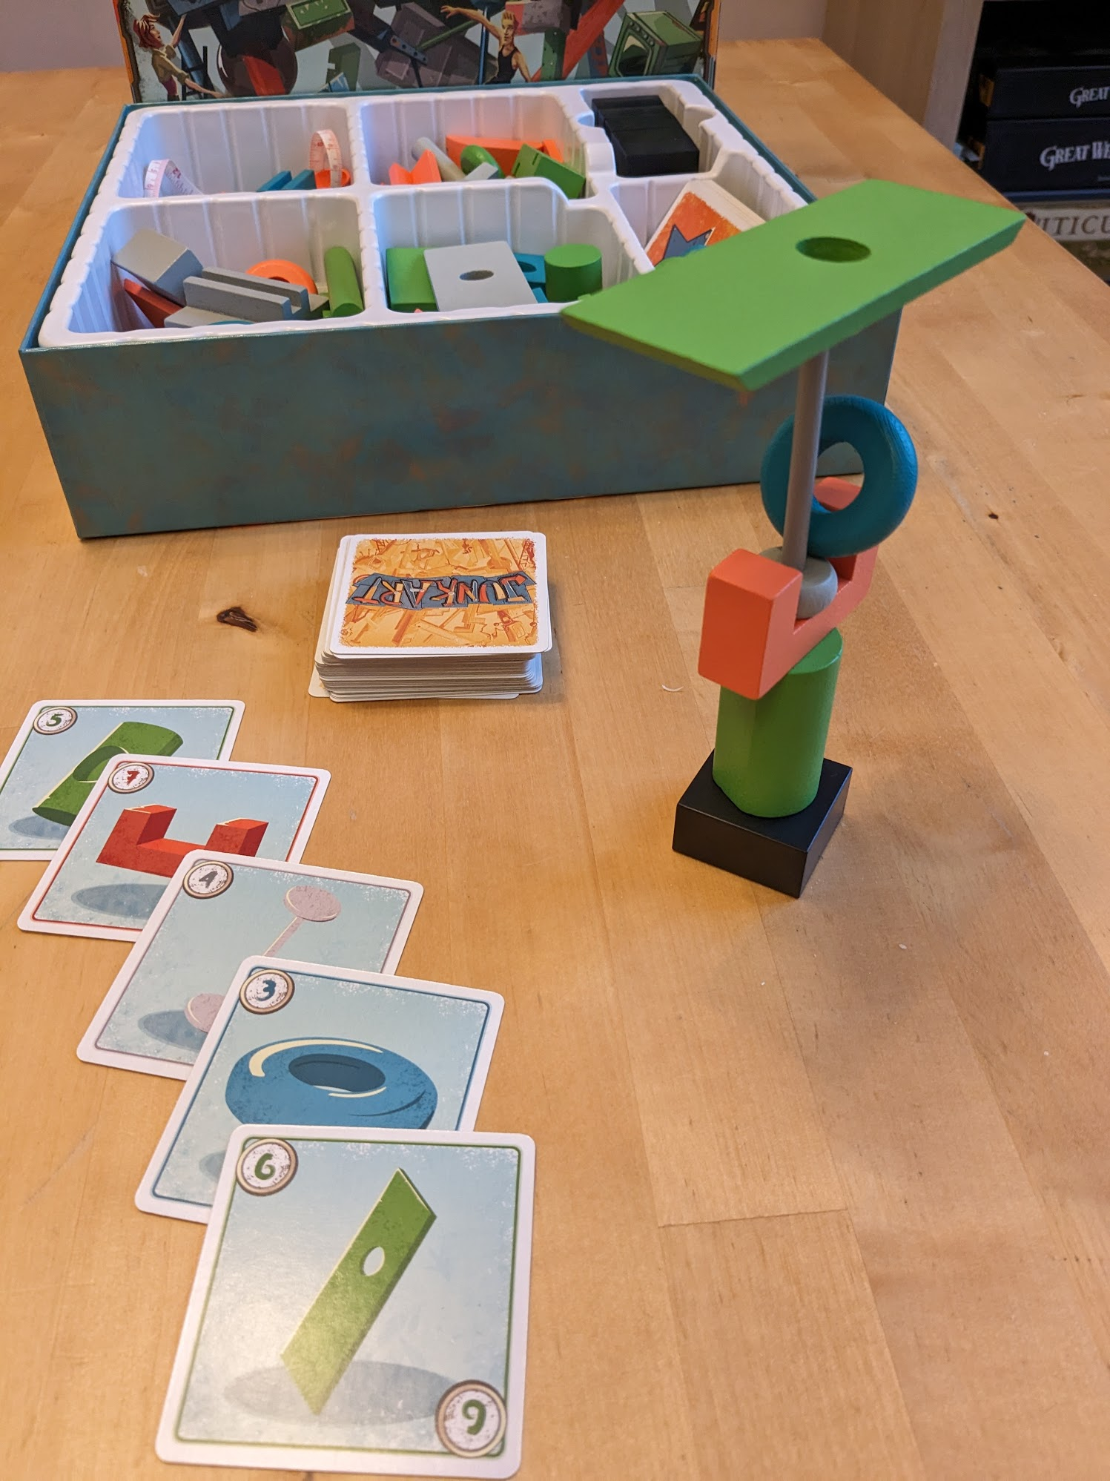
Junk Art
Physics simulation of stacking objects
Rules of game enforced
Automated scoring
‘Hotseat’ local multiplayer

